Slide 1
Particles

Slide 2
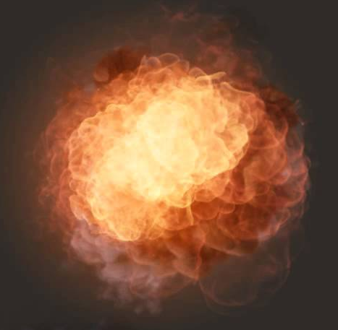
What are particles used for?
“Fuzzy” phenomena
Fire
Smoke
Explosions
Weather effects
Phenomena which:
Change over time
Have no definite shape
Can’t be accurately rendered with a static mesh

Slide 3

What’s a particle?
Smallest individual piece of the phenomenon
Snowflake
Drop of rain
Single flame
Each moving “piece” to the right is a particle

Slide 4
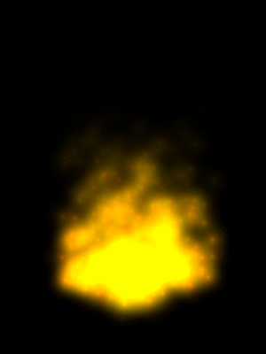
What can individual particles do?
Any/all of the following:
Move / Spin / Resize
Be affected by gravity
Fade in / out
Change color
Animate (swap textures)
Spawn / die / recycle
And more
Spawn, fade out & move up, recycle

Slide 5
What data makes up a particle?
Any data that is unique to each particle
At a minimum:
Position
Age
Could also have:
Scale
Alpha
Color tint
Z Rotation
Velocity
Sprite sheet frame
And much more

Slide 6
Organizing particles
A single particle isn’t enough
We need many of them
Tens, hundreds, maybe thousands
For each phenomenon we want to simulate
Emitters
Objects that each control a single set of particles
Sometimes referred to as “particle systems”

Slide 7
Emitter
Object that controls a group of particles
What’s an emitter do?
Spawns (emits) particles
Updates (simulates) particles: move, fade, spin, etc.
“Kills” or recycles particles
Draws particles (potentially)

Slide 8
How many emitters?
One for each group of particles
5 torches in your game?
Each needs a fire emitters (5 total)
Is it snowing?
Make a huge snow emitter in the sky
Sparks when player’s sword hits metal?
Attach a spark emitter to the sword

Slide 9
What data makes up an emitter?
Particles themselves
Any data that is the same for all particles
At a minimum:
Max particle count
Array of particles
Emitter position
Emit rate (particles/sec)
Could also define:
Type of emission
All at once? Explosions!
Over time? Fire/rain/etc.
Spawn area – Point, box, etc.
Looping – recycle particles?
Material – Texture, blend, etc.
Forces – Gravity, wind, etc.
Randomization ranges
And more

Slide 10
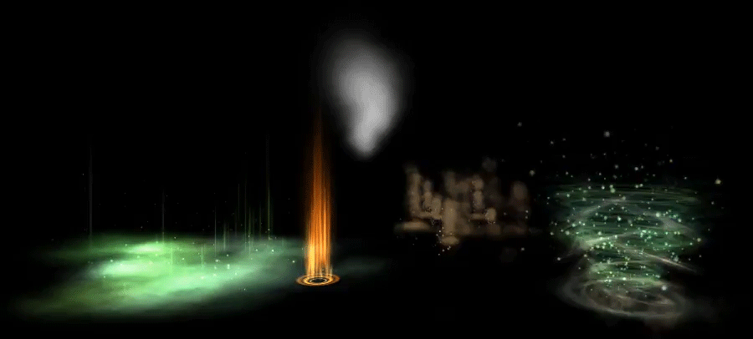
Multiple emitters for one effect
Individual “effects” often comprised of multiple emitters

Slide 11
Particle Implementation

Slide 12
Approaches to particle systems
CPU-based
CPU does most of the work (including simulation)
Updated particles copied to GPU every frame
CPU/GPU Hybrid
CPU handles some work (killing/spawning particles)
GPU handles some work (particle motion & colors)
Still requires some CPU -> GPU copying
Pure GPU (Advanced)
GPU does it all: Spawns, updates and kills particles
More on this when we get to Compute Shaders

Slide 13
This approach: CPU-based
Simple to implement & debug
As much of the implementation as possible is C++
Fast enough for this semester
Easy to move to CPU/GPU hybrid approach
Once its working
And testable
And you understand it!

Slide 14
Particle systems in code
Particle - Struct of relevant particle data
Emitter
A class which tracks its own particles
Has particle behavior & spawning options
Methods to update its own particles
Overarching “Particle System”
Updates & Draws all emitters in a scene
Could simply be an array of Emitters
Or even handled by a renderer class

Slide 15
Particle system steps
Simulation
Creating & updating individual particle data
Position, velocity, color, rotation, etc.
CPU -> GPU Copy
Copy updated particles to GPU buffer
Usually a dynamic vertex buffer
Render
Actually draw each emitters’ particles
Using specific shaders and render states

Slide 16
Code Setup
CPU-Based Approach

Slide 17
Emitter setup for CPU approaches
Each emitter needs an array of its particles
Note: Not all of this data is required for rendering
Particle 0 | Particle 1 | Particle 2 | …
Position Velocity Color Size Age Etc. | Position Velocity Color Size Age Etc. | Position Velocity Color Size Age Etc. | …

Slide 18
Particle definitions
Particle (Simulation)
Assuming a const accel function for movement
struct Particle
{
DirectX::XMFLOAT3 Position;
DirectX::XMFLOAT4 Color;
DirectX::XMFLOAT3 StartVel;
float Size;
float Age;
};
Particle (Drawing)
Just what we need to send to GPU for drawing
struct ParticleVertex
{
DirectX::XMFLOAT3 Position;
DirectX::XMFLOAT2 UV;
DirectX::XMFLOAT4 Color;
float Size;
};

Slide 19
Storing particles in an Emitter
Emitter will need an array of particles
Particle* particles;
Also handy to have array of particle vertices
Need 4x as many vertices as particles!
We update it locally as particles change
And copy to GPU in one step before rendering
ParticleVertex* localParticleVertices;

Slide 20
Tracking particles CPU-side
Need to track both living and dead particles
Dead particles often get recycled into living ones
Subset of all particles will be “alive” at a time
Usually grouped together
Especially if all particles have the same lifetime
0 | 1 | … |  |  |  |  |  |  |  |  |  |  |  | … | N
Dead
Living
Not yet emitted

Slide 21
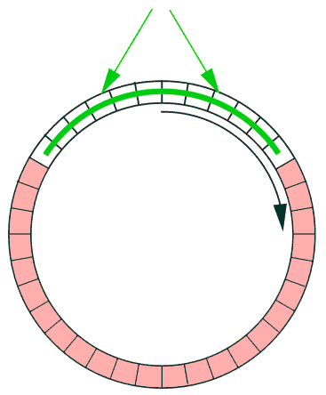
Circular buffer
Treat particle list as a circular buffer
Oldest living particle (next to die)
Start of buffer
...
2
1
0
Living particles
N
End of buffer
Youngest living particle
Next particle to be emitted

Slide 22
Particle Simulation
CPU-Based approach

Slide 23
Simulation
This is where you update each particle’s data
Update velocity and position
Interpolate colors, size, rotation, etc.
Increment age
And emit new particles
If enough time has passed
And check for “dead” particles
Particles whose age > lifetime
Reset dead particles if looping

Slide 24
Particle emission
Particles are slowly emitted over time
Usually not all at once
Unless that’s what you want (explosions?)
Where do new particles spawn?
Could be a point in space
Or randomly inside a volume (box, sphere, etc.)
Stops when max # of living particles reached
As particles die, they can be recycled

Slide 25
Emitting a single particle
Newly emitted particles have default state:
Starting position
Starting velocity
Initial color, size, rotation, etc.
Age = zero
Age lets us keep track of when a particle dies
Compare particle’s age & emitter’s lifetime property
Here is where some randomization helps
Makes the system more visually interesting

Slide 26
Updating particles
Each frame, all living particles are updated
Common data to update:
Increment the age
Adjust position
Constant acceleration function?
Or simply “vel += acc; pos += vel;”
Change color, size, rotation, etc.
foreach(Particle p) { Update(p); }
One at a time? Isn’t that slow?
YUP

Slide 27
Emitters & “dead” particles
When a particle’s age exceeds its lifetime:
Particle is dead - No longer rendered or simulated
Looping emitters:
“Dead” particles are put back in queue
Eventually re-emitted
Examples: fire, rain, snow
Non-looping emitters:
Particles eventually stop (effect ends)
Examples: explosion, blood splatter

Slide 28
CPU -> GPU Copy
CPU-Based approach

Slide 29
GPU setup for basic particle system
Need GPU buffer of vertices for rendering
Contains per-vertex rendering data
How many verts per particle? Options:
6 per particle: Two triangles, no indices
4 per particle: If using an index buffer
1 per particle: If using a Geometry Shader
Vertex 0 | Vertex 1 | Vertex 2 | …
Position UV Color Etc. | Position UV Color Etc. | Position UV Color Etc. | …

Slide 30
GPU buffer for particles? Dynamic!
We use static buffers for normal geometry
Lives in GPU memory
Can’t be updated after creation
Vertex shader handles transformations
Dynamic buffers allow the CPU to write new data into them at run time
Definitely slower than static buffers
But faster than creating new buffers each frame
More info on dynamic resources in DirectX

Slide 31
Dynamic vertex buffer creation
Set up your buffer description:
“Usage” attribute -> D3D11_USAGE_DYNAMIC
“CPUAccessFlag” -> D3D11_CPU_ACCESS_WRITE
Dynamic buffers are optimized differently:
Designed for frequent locking/unlocking
Often lives in CPU memory until needed for drawing
Can be used along with a static index buffer
Only the vertex data is changing, not the order

Slide 32
Create a dynamic vertex buffer
// Set up buffer description
D3D11_BUFFER_DESC vbDesc = {};
vbDesc.BindFlags = D3D11_BIND_VERTEX_BUFFER;
vbDesc.CPUAccessFlags = D3D11_CPU_ACCESS_WRITE;
vbDesc.Usage = D3D11_USAGE_DYNAMIC;
// Enough room to store potentially all particles
vbDesc.ByteWidth = sizeof(ParticleVertex) * 4 * maxParticles;
// No initial data necessary – we’ll copy into it later
device->CreateBuffer(&vbDesc, 0, &emitterVertBuffer);

Slide 33
Writing to a dynamic buffer
You need to lock your buffer before writing
Also called “mapping” and “unmapping”
GPU not allowed to use mapped resources
context->Map()
Use the D3D11_MAP_WRITE_DISCARD flag
Tells DirectX it can safely discard old data (faster)
Copy vertex data into the buffer
context->Unmap() to unlock the buffer

Slide 34
Copying to dynamic buffer
// All particles sent to GPU with one memcpy() call
// This means we need a local copy of all particle VERTICES!
// Map() will LOCK the buffer – GPU can’t touch until unlocked
D3D11_MAPPED_SUBRESOURCE mapped = {};
context->Map(
emitterVertBuffer, 0, D3D11_MAP_WRITE_DISCARD,
0, &mapped);
// Mem-copy is FAST! All data copied quickly
memcpy(mapped.pData, // Destination
localParticleVertices, // Source
sizeof(ParticleVertex) * 4 * maxParticles); // Size
// Unmap (unlock) the buffer so GPU can use it again
context->Unmap(emitterVertBuffer, 0);

Slide 35
Copying vertices to GPU
GPU needs rendering info: Position, color, etc.
After CPU has updated it for the frame
Copy to the emitter’s dynamic buffer
Overwriting the old data
Could we store data exclusively on GPU?
Not with a CPU-based approach!
Best to keep data CPU-side and copy to GPU
Remember: GPU -> CPU read-back causes stalls!

Slide 36
Creating vertices from particles
Usually need multiple vertices per particle
Particle 0 | Particle 1 | Particle 2 | …
Position Color | Position Color | Position Color | …
“Simulation” Particles
Vertex 0 | Vertex 1 | Vertex 2 | Vertex 3 | Vertex 4 | …
Pos + TopLeft Color UV (0,0) | Pos + TopRight Color UV (1,0) | Pos + BotRight Color UV (1,1) | Pos + BotLeft Color UV (0,1) | Pos + TopLeft Color UV (0,0) | …
“Drawing” Particles

Slide 37

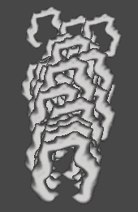
Should particles be sorted?
Not necessary for the following cases:
Additive Blending
Alpha Cutout
Results are the same regardless of order
(A + B = B + A)
No actual blending here
Depth buffer does the work

Slide 38
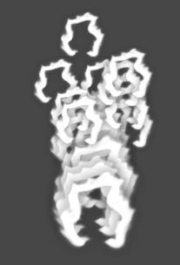
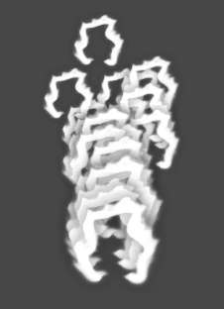


Sorting for alpha blending
Could sort alpha blend particles back to front
Sort particles as they’re copied to GPU buffer
Not 100% necessary
Tradeoff: Accuracy vs. Speed

Slide 39
Particle Rendering
CPU-Based approach

Slide 40


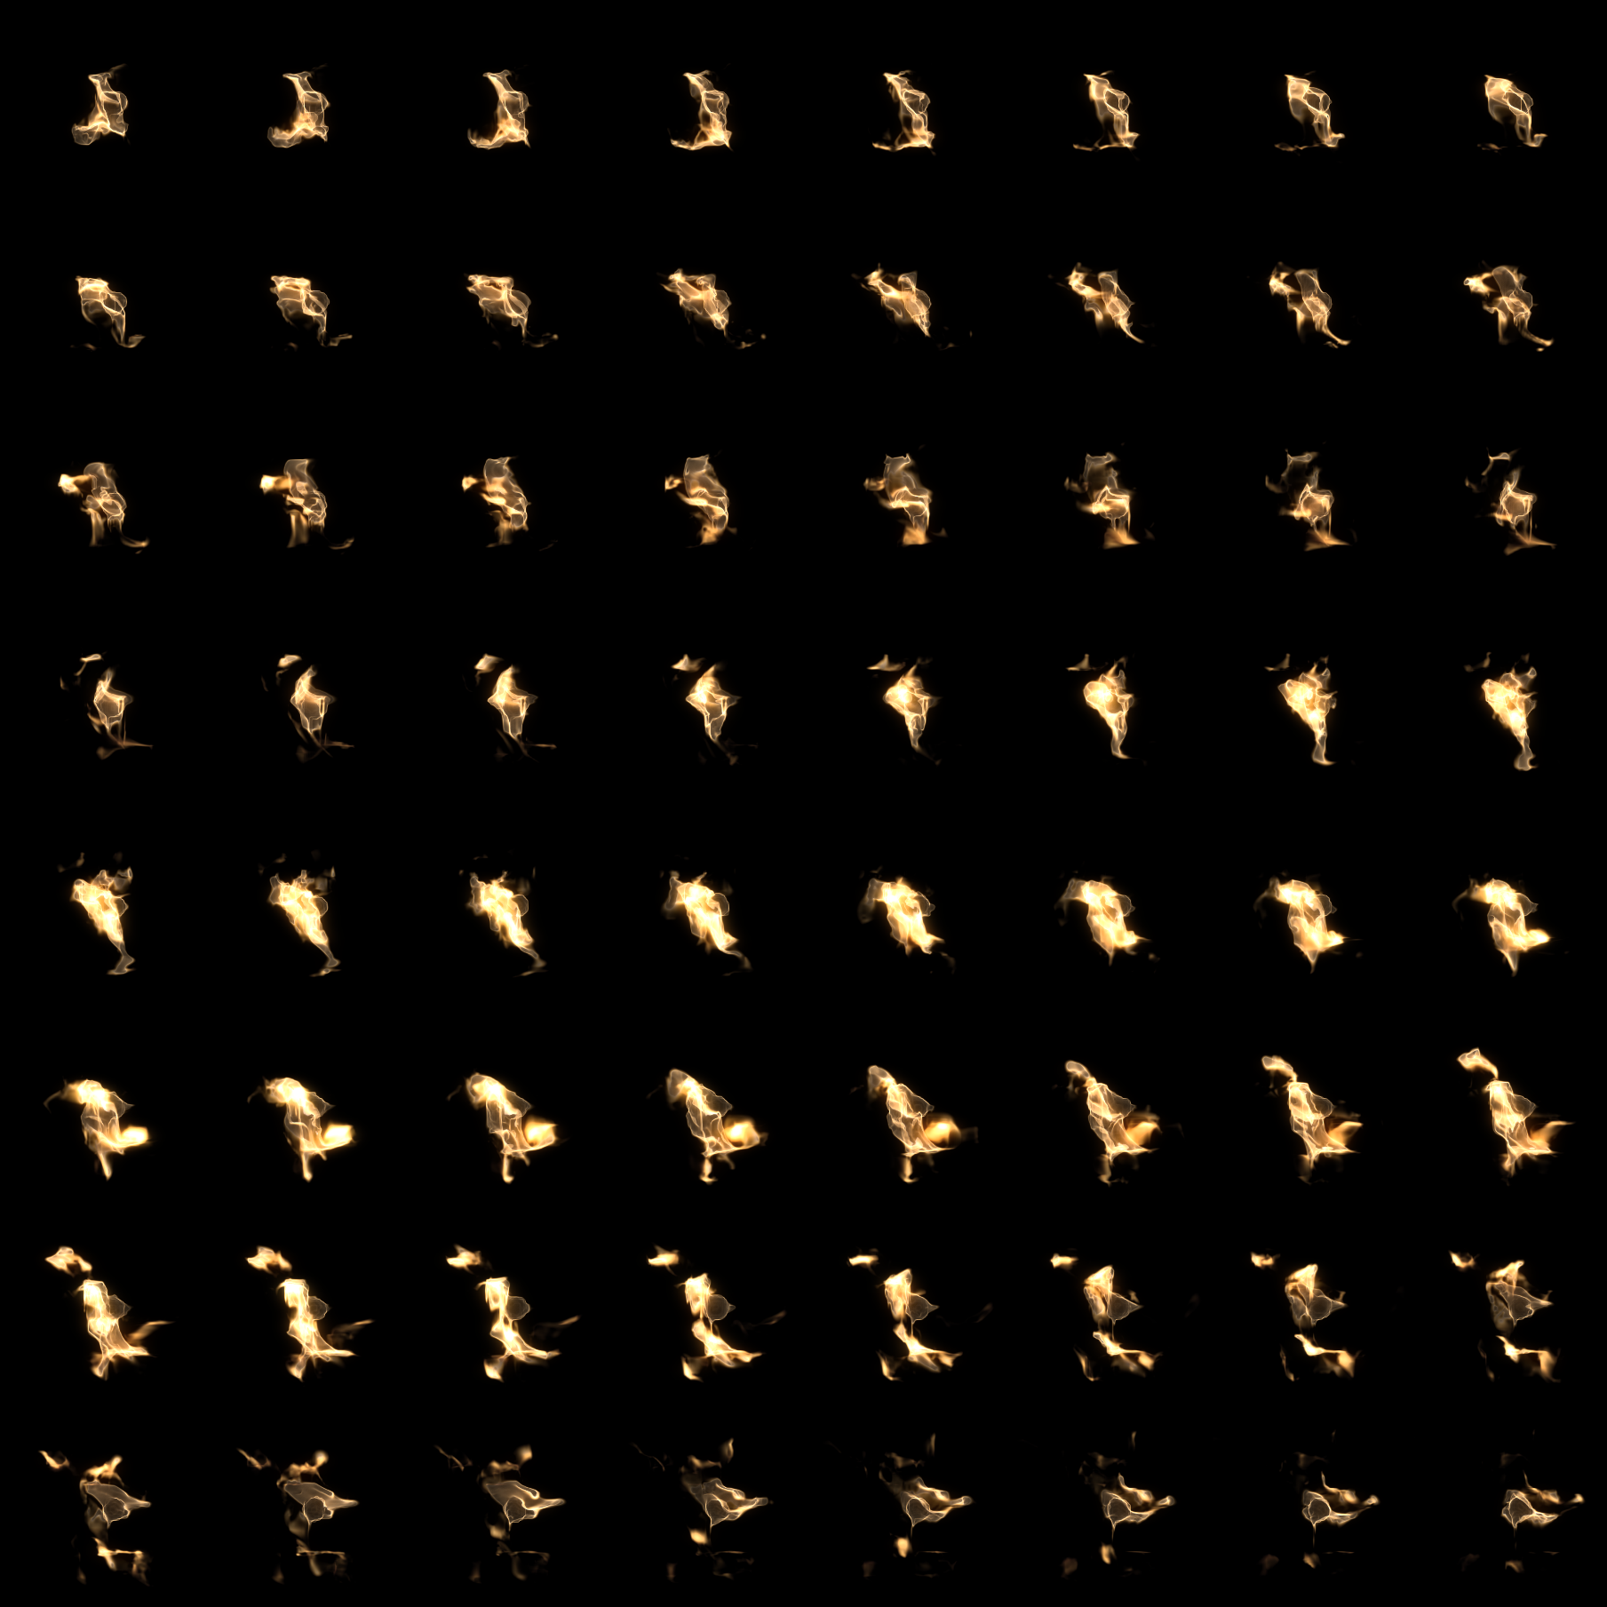
How are particles rendered?
Rendered as a quad (two triangles)
Texture options:
Transparent (alpha blend)
Black background (additive blend)
Animated sprite sheet
Etc.

Slide 41

Particle orientation
Particles move (simulate) over time
What about rotation?
Billboarding!
Particles always face the camera
You always see each particle head-on
Ensures system looks good from any angle

Slide 42
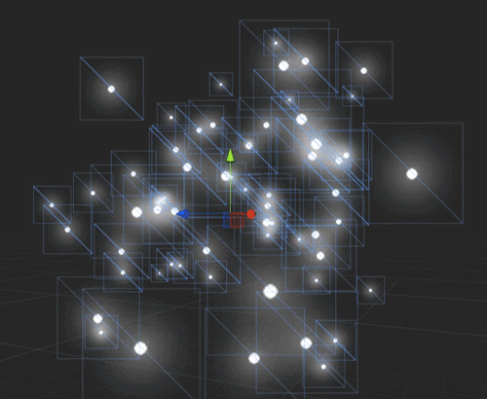
Billboard example

Slide 43
Billboarding implementation
You have camera’s view matrix
Grab up and right vectors directly from matrix
All 4 vertices start at particle center
Move each one using cam’s up & right vectors
Scale by particle size
Can handle Z rotation here, too
x4

Slide 44
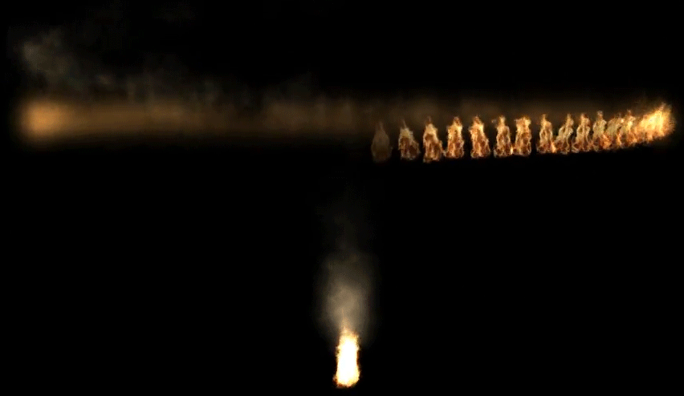
World space vs. Local space

Slide 45
World space particles – fire trails
Emitter’s position moves
Particles spawn at emitter’s current position
World matrix for drawing?
Identity matrix
Each particle already has a position in world space

Slide 46
Local space particles – jet engines
Emitter’s position moves
Particles spawn at origin (0,0,0)
World matrix for drawing?
Translation matrix based on emitter’s position
Each particle remains “local” to the emitter

Slide 47

Particle shaders
Vertex shader
Standard world/view/proj
Pass UV’s & color tint through to pixel shader
No normals or lighting to worry about
Pixel shader
Sample texture
Apply color tint

Slide 48
Rendering particles
Are we drawing each particle separately?
No.
No no no no no.
NO!

Slide 49

Rendering particles
Are we drawing each particle separately?
No.
No no no no no.
NO!

Slide 50
Parallelize the particle rendering!
Render lots of particles each Draw()
At least one emitter worth of particles
One particle at a time is the WORST possible case
Plus, each Draw() has some overhead
Having tons of emitters can be a slowdown
But 10 emitters is only 10 draw calls
Rather than 1 draw for each particle of each emitter

Slide 51
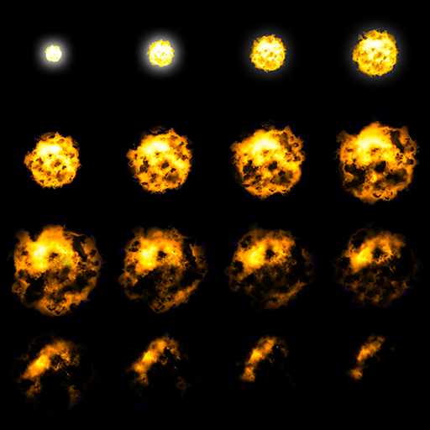
Rendering an emitter
All particles of an emitter are similar
They all will use the same:
Shader
Blend mode
Texture – Even with animation →
Unique, per-particle data should be in the emitter’s dynamic vertex buffer
Particles’ position, color, rotation, etc.

Slide 52
DirectX render states for particles
Turn off depth writing when necessary
Additive particles should NOT write to depth buffer
Otherwise some particles “occlude” others
Setup: Change depth state’s DepthWriteMask
Use different blending modes as necessary
Alpha clipping for “solid” particles (leaves, dirt)
Alpha blending for “cloudy” particles (smoke)
Additive blending for “glowing” particles (fire)

Slide 53
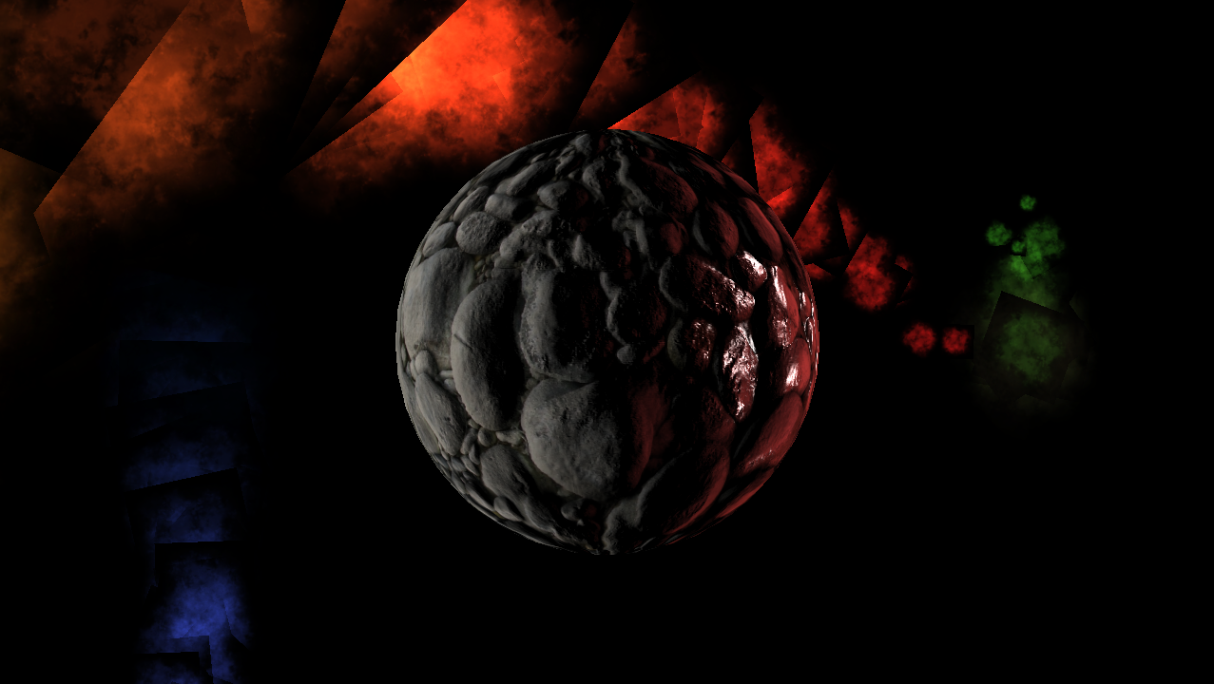
Additive blending with depth writing (Bad)
Notice the “blocky” (and not glowy) look
Closer particles partially obscure further ones

Slide 54
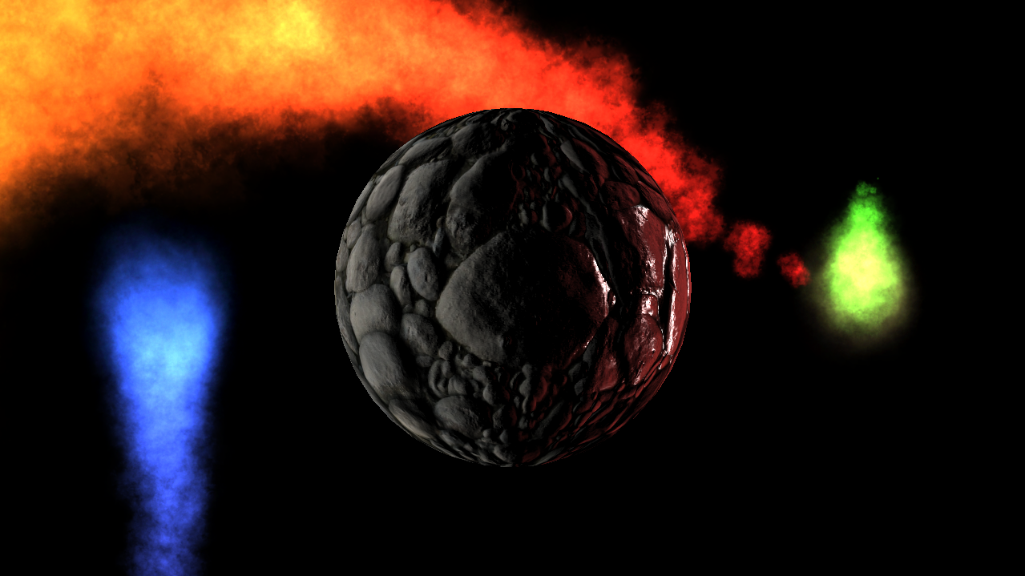
Additive blending without depth writing
With depth writing off, particles additively blend properly

Slide 55
Where do particles fit into rendering?
void Draw()
{
Render all opaque scene geometry
Render opaque alpha cutout emitters
Render the sky
Interleave the following as necessary:
Render additively blended emitters
Render alpha blended emitters (maybe sorted?)
Render transparent scene geometry (sorted!)
}

Slide 56
Conclusions
CPU-based approach

Slide 57
CPU-based approach: Conclusion
CPU-based particle systems work pretty well!
Feel free to create them this semester
Advantages
“Easy” to implement (less shader magic)
Easy to debug simulation
CPU particles could collide with physics objects
Disadvantages
Some obvious performance issues
Lots of O(n) loops for updating & copying

Slide 58
Improvements & Optimizations

Slide 59
Problems w/ CPU-based approach
Simulation step can be slow
Tens, hundreds, millions of particles?
You’re updating one at a time – O(n)
CPU threading may help a little? (if done properly)
Copy step can be slow
Dynamic buffers are slower than static buffers
Copying less data would be better
Rendering
Need 4 vertices per particle (or do we?)

Slide 60
Simulation improvements?
Particles are basically a couple of vertices
GPU parallelizes vertex processing
Can we offload some “updating” to shaders?
Vertex Shader can calc anything based on age
Position (constant acceleration function)
Lerp (or tween) between start/end values
Color
Size
Rotation
Etc.

Slide 61
VS – Constant accel function
Vertex Shader can do the heavy lifting here:
// Calculate time since spawn
float t = currentTime – particle.SpawnTime;
// Figure out the particle’s world pos
float3 worldPos =
0.5f * t * t * acceleration +
t * particle.InitialVelocity +
particle.InitialPosition;
// Could do billboarding here too! Then view/proj

Slide 62
CPU still doing some work
CPU will still need to emit particles
And track their ages
And kill/recycle them as necessary
Drawbacks
No easy way to do collisions on GPU
No easy randomness in a shader
Depends on the needs of your game/engine

Slide 63
Copy improvements?
Currently we replicate each particle x4
Since we need 4 vertices per particle
Would be nice to NOT have to do that
Maybe we can just copy each particle once
With less per-particle data
Since much could be calc’d based on age

Slide 64
Structured buffers
A DirectX buffer could hold any data
Including a bunch of particle data
Like a big array of particle structs
A shader can treat a buffer as a StructuredBuffer
Shader interprets it as an array of structs
Which structs? Whichever we define!
(Do you see where this is going?)
StructuredBuffers can be indexed into
By using the Load() method in the shader
particleBuffer.Load(index);

Slide 65
Structured buffers in practice
Init: Make the buffer and an SRV for it
Update: Copy particles to it each frame
Draw:
Set buffer for VS stage (not pixel shader!)
Unbind vertex buffer (don’t need it!)
Draw NumParticles * 6 indices
Programmatically determine particle id in shader
Vertex Shader input is (uint id : SV_VertexID)
particleIndex = id / 4;
See hybrid demo for details!

Slide 66
Render optimizations?
Reduce draw calls!
Only draw emitters you can “see”
Tough to get perfect as particles move around
Overestimate full system size to reduce popping
Sub-emitters
50 torches in a room? All similar particles!
Could be one draw call
Define multiple spawn positions for a single emitter

Slide 67
Geometry shaders? Ehhh…
Can create quad procedurally on the GPU
Only need 1 vertex per particle
Set “point” primitive topology in DirectX
During pipeline, Geometry Shader can:
Create 2 billboarded triangles
Triangles would then get rasterized as expected
See Geometry Shader slides for more info
Problem: Geometry Shaders are SLOOOOOW
Almost always faster to just use more vertices

Slide 68
The new hotness: Compute Shaders
DirectX 11 introduced HLSL Compute Shaders
Runs on GPU – Not part of the rendering pipeline!
Provides highly-parallel general shaders
(More in a few weeks)
Can read from and write to structured buffers
A buffer of structs in GPU memory (like particles)
Entire system can exist on the GPU!
See second half of Compute Shader slides
For info on compute particle implementation

Slide 69
Particle System Examples

Slide 70
Simple effects
Simple particle system = simple effect

Slide 71

Complex effects
May require multiple different emitters
And animated textures, geometry, lights, etc.

Slide 72
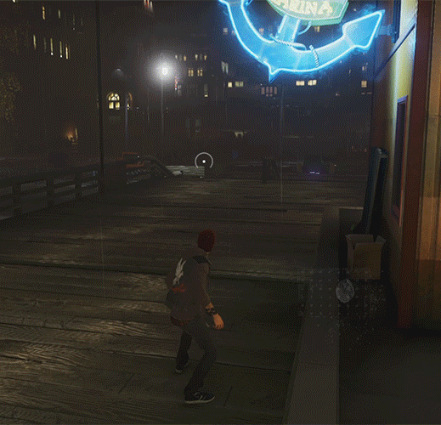
And then there’s inFAMOUS…
Can spawns particles on a mesh
Moves them towards character
“Curl noise” for fluid-like flow
Some particles procedurally “ribbonized”
All done w/ compute shaders!

Slide 73

Character particles too
Spawn particles on mesh – then hide mesh
Animate particles during attack
Particles reform into shape – then show mesh

Slide 74
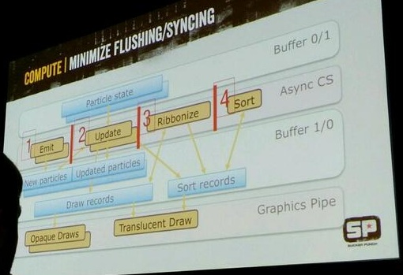
Slide From inFAMOUS GDC Particle Talk

